Slide 1


BRANCH OFFICE : BANGALORE
WELCOMES ALL THE PARTICIPANTS

Slide 2
INTRODUCTION
Established in the year 1955
Functioning under the Ministry of Micro, Small and Medium Enterprises (MSME), Govt. of India.
AIM: “aid, counsel , assist, finance, protect and promote the interests of micro & small enterprises in India”

Slide 3
ORGANISATION STRUCTURE
Head Office
Zonal
Offices
(9)
Foreign
Office(1)
NTSCs/NTSECs
(8)
Software
Technology
Parks(2)
Branch &
Other Offices
(117)

Slide 4

NSIC’s schemes are classified as under:
Marketing
Technology
Credit
Support
Services

Slide 5
WHAT is MSME ? How is MSME Defined ?

Slide 6
DEFINITION OF MSME
MANUFACTURING SECTOR
ENTERPRISES | INVESTMENT IN PLANT & MACHINERY
MICRO ENTERPRISES | DOES NOT EXCEED TWENTY FIVE LAKH RUPEES
SMALL ENTERPRISES | MORE THAN TWENTY FIVE LAKH RUPEES BUT DOES NOT EXCEED FIVE CRORE RUPEES
MEDIUM ENTERPRISES | MORE THAN FIVE CRORE RUPEES BUT DOES NOT EXCEED TEN CRORE RUPEES
SERVICE SECTOR
ENTERPRISES | INVESTMENT IN EQUIPMENTS
MICRO ENTERPRISES | DOES NOT EXCEED TEN LAKH RUPEES:
SMALL ENTERPRISES | MORE THAN TEN LAKH RUPEES BUT DOES NOT EXCEED TWO CRORE RUPEES
MEDIUM ENTERPRISES | MORE THAN TWO CRORE RUPEES BUT DOES NOT EXCEED FIVE CORE RUPEES

Slide 7
MARKETING SUPPORT
Single Point Registration Scheme under Govt. Stores Purchase Programme
Consortia & Tender Marketing
Raw material Distribution
Exhibitions & Buyer Seller Meets
Credit Facilitation
Performance & Credit Rating Scheme.

Slide 8







SINGLE POINT REGISTRATION SCHEME or GOVERNMENT STORES PURCHASE PROGRAMME
Benefits of the Scheme
Issue of tenders free of cost.
Exemption from payment of Earnest Money Deposit.
Price preference up to 15% over the quotations of the large scale industries – being modified.
Registration starts at Rs. 10000.00 (plus service tax) for 2 years certifications only.

Slide 9
CONSORTIA AND TENDER MARKETING SCHEME
Participate in Govt. Tenders through NSIC
NSIC participates in Govt. tenders on behalf of MSMEs and procures the orders, MSMEs in turn execute the same.
All the benefits under the Single Point Registration Scheme is applicable to all MSME units in this scheme.
Avail tender leads and Govt. department enquiries through NSIC directly

Slide 10
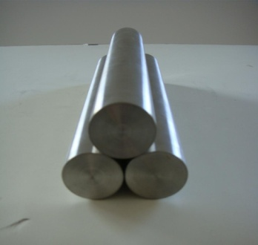
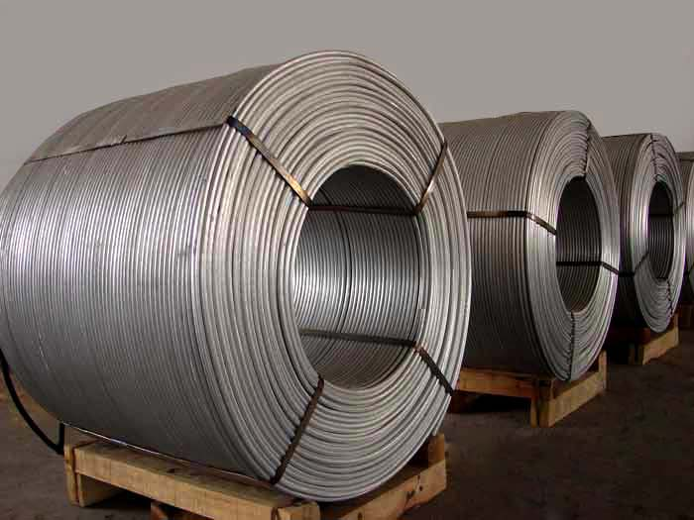
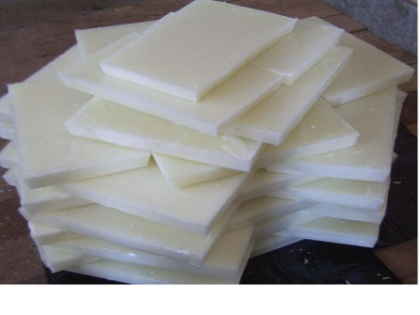
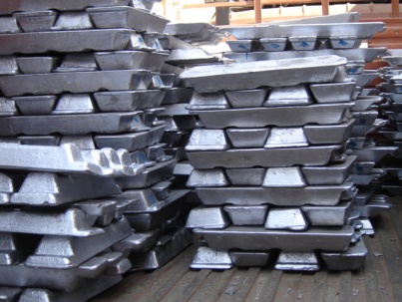
RAW MATERIAL DISTRIBUTION
NSIC distributes basic raw materials for MSMEs at basic production price and passes on discounts and rebates to MSMEs procuring raw material.
NSIC distributes the following raw material:
Iron & Steel: RINL, JSW, SAIL
Aluminium: NALCO, BALCO
Zinc: Hindustan Zinc Limited
Copper: Hindustan Copper Limited, Sterlite Copper Ltd.
Wax: CPCL, IOCL

Slide 11
RAW MATERIAL ASSISTANCE
Financial assistance against Bank Guarantee for procurement of any raw material on credit up to 90 days, from any supplier, indigenous or imported.
Bulk purchase of basic raw materials like Aluminum from NALCO & BALCO, Copper from HCL, STERLITE, Zinc from HZL, Paraffin Wax from CPCL, Steel from SAIL, RINL, JSW, ESSAR at very competitive rates under the allocation from the Ministry.
NSIC makes 100% immediate payment to the suppliers irrespective of its location, on the basis of invoice/ proforma supplied by the MSMEs units. The MSME unit can purchase any raw material from any supplier from anywhere in the globe.
Scope for utilizing non fund based limits like Bank Guarantee from any bank and convert it into fund based limits.

Slide 12
DOMESTIC EXHIBITIONS
NSIC Facilitates MSMEs to showcase their competencies through participation in national & international exhibitions / trade fairs organized in India by providing space at concessional rates as given below:
Category of the Enterprises | General | NER (North Eastern Region) / SC/ST/Women
Micro | 75% | 95%
Small | 60% | 85%
Medium | 25% | 50%

Slide 13
ASSISTANCE TO PARTICIPATE IN INTERNATIONAL EXHIBITIONS
Provides assistance to MSMEs for space rental and air fare to exhibit their products in the exhibitions held in foreign countries as given below:
 | Space Rental |  | Air fare
 | General | NER/SC/ST / Women | General | NER/SC/ST/ Women
Micro | 75% | 95% | 85% | 95%
Small | 60% | 85% | 75% | 85%
Medium | 25% | 50% | 25% | 50%
Maximum amount of assistance towards air fare, rental and freight charges varies from Rs. 0.75 lac to Rs. 2.00 lakhs depending upon the category of entrepreneur and place of exhibition.

Slide 14
CREDIT SUPPORT
NSIC long term financing scheme was generating a lot of Net Performing Assets.
To obviate further losses and to continue to facilitate credit, Memorandum of Understanding (MOU) were signed with 21 commercial banks.
Helps in preparation of credit proposals of MSEs and forwards to these banks & follows up for sanction
Empanelled Banks involve – Central Bank of India, UCO Bank, SBI, SBH, Bank of Baroda, Bank of Maharashtra, SBT, Yes Bank, Axis Bank, OBC, HSBC, Vijaya Bank, Canara Bank, Vijaya bank, Federal Bank, etc, to name a few…

Slide 15
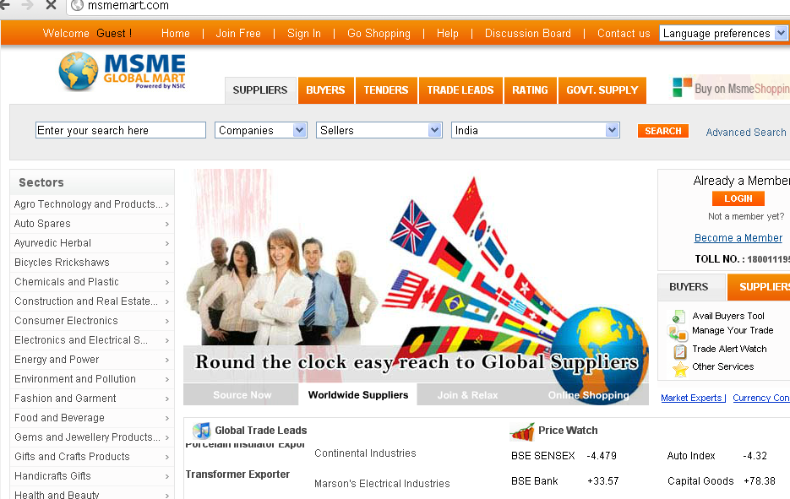
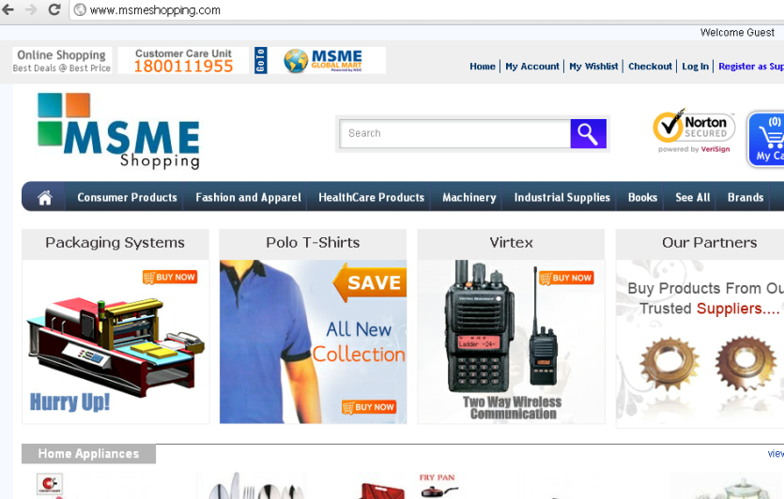
NSIC’S NEW B2B PORTAL FOR MSMES
NSIC has always been striving to deliver something innovative and economic for the MSME units. The recently launched B2B portal and B2C portal exclusively for SSI units is boon for the sector.
www.msmemart.com www.msmeshopping.com
Registration starts at Rs. 5000.00 per annum

Slide 16
NSIC’S B2B PORTAL FOR MSMES
Tender Information with email alerts
Global Trade Leads
Technology Search
Global Mart for e-commerce & web portal (www.msmemart.com)

Slide 17
NSIC – TRAINING and INCUBATION CENTRE (TIC)
NSIC Training-cum-Incubation Centers provide an opportunity to first generation entrepreneurs to acquire skill for enterprise building and also incubating them to become successful small business owners
INDICATIVE LIST OF TRAINING MODULES FOR NSIC-TIC
COMPUTER COURSES
Office Automation through ICT
Programme in Website Design Certificate
Programme in AutoCAD
Multi-Media / Graphic Design Training
Certificate in Computer Concepts
Certificate course in Computerized Accounting
C, C++ and OOPs
Core Java programming
Advanced Java programming Visual Basic with Access
Oracle, SQL and PL SQL
MS.NET programming
CONVENTIONAL TRAINING
Pneumatics operation training
Hydraulics operation training
Book binder
Digital Photography & processing
Spray Painting
Powder Coating
ELECTRONIC COURSES
Mobile Repairing
Radio and TV repair
Repairing of electrical gadgets
Repair of refrigerator & AC
Electrical appliances repairing

Slide 18






PERFORMANCE AND CREDIT RATING
Helps MSMEs in accessing credits from banks & financial institutions, orders from foreign buyers.
Helps in assessing their strengths and weaknesses.
Rating by one of the empanelled Rating agencies.
Government subsidizes 75% of the cost of Rating fee up to maximum of Rs. 40,000/ USD800)
Concessional credits from Banks/FIs to such rated units.

Slide 19
THANK YOU
FORUM OPEN FOR QUERIES ?

